Slide 1
National-Level Training for State level Trainers
23rd & 24th October 2024
Mr Amgothu Sri Ranga Naik
Commissioner Health Services and Mission Director
NHM Maharashtra
Maharashtra Experience: Ensuring Quality care in Sickle Cell Patients

Slide 2
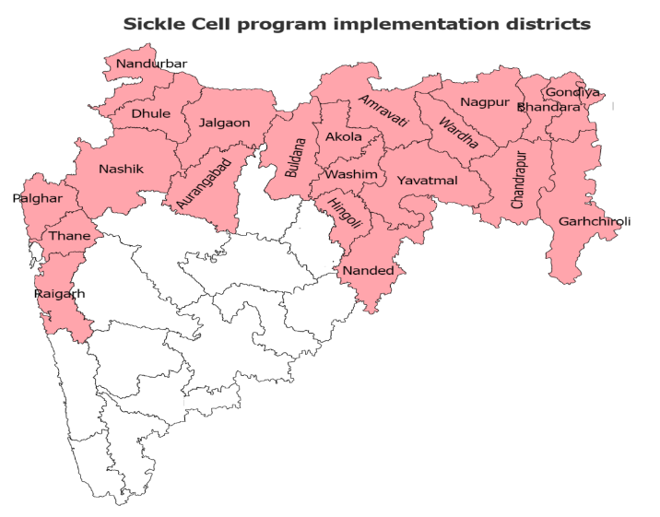
Introduction
Total state population: around 12 Cr (Census 2011)
Maharashtra has 36 districts and 21 tribal districts that are covered under Sickle Cell Program
Sickle cell control program is being implemented since 2008
National Sickle Cell Anemia Elimination Mission was launched in 2023 with the aim to eliminate sickle cell disease as a public health problem before 2047 through awareness, screening, and treatment initiatives.
Reducing the burden of the disease and improving healthcare access and quality of life of the affected population is the major focus of the program

Slide 3
Elimination of Sickle cell by 2047
Program Activities Outline
Universal Screening
(Target for 2023-25)-
62,89,923 tests
Counselling and general awareness
Holistic Management
Hydroxyurea
Folic acid
0-40 age group
ANCs
Newborn screening
Pain Killers
Blood Transfusion
Household level
Community level
School level*
(Teachers and RBSK team)
Healthcare level
(SCD, NCD & RKSK counselor)
Management of
Complications (ventilator support, antibiotics, ICU bed, management of AVN)
ASHA/ANM/MPW/CHO
*School going children: Tribal schools, EMRS, pvt. schools etc. Teachers and wardens are sensitized about SCD and when to refer the students to nearest healthcare facility

Slide 4
Screening Protocol
Universal Screening
(Target for 2023-25)-
62,89,923 tests
0-40 age group*
ANCs
(preferably in 1st trimester)
New born
Screening through solubility testing
Confirmation by HPLC through HLL at DH, WH, SDH, RH and PHC, HWC level
HPLC testing (DBS) through HLL within 48 hours of birth at DH, SDH, RH and PHC by heel prick method
Repeat confirmatory testing at 6 months of age by HPLC.
HPLC testing through KRSNA diagnostics and Sankalp Foundation
Testing of partners of all SCT and SCD ANCs by HPLC
*Preference for screening:
Tribal population, and schools including: tribal hostels, EMRS schools, Ashramshala, all schools like zila parishad, pvt. schools in tribal belt

Slide 5
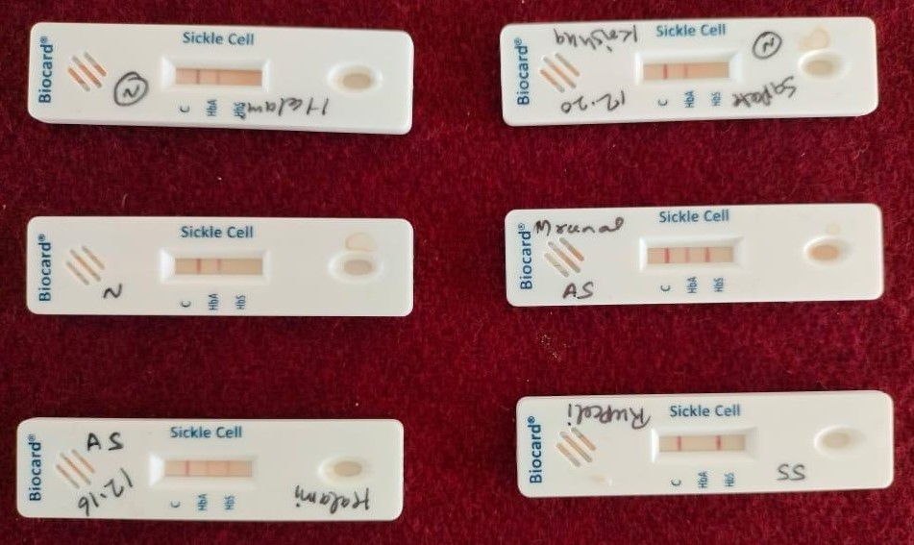
Point of Care test
Approx. 130,000, ICMR approved sickle cell rapid test kits (Trivitron) have been procured @Rs.44 per test only and deployed in 7 districts viz. Amravati, Nashik, Nandurbar, Gadchiroli, Chandrapur, Palghar, and Nagpur.
POC positive individuals to be confirmed by HPLC testing before initiating treatment with hydroxyurea.
Training for testing using POC provided to healthcare staff
At PHC level POC is being used for ANC screening preferably in 1st trimester
For internal quality testing of POC
6 samples:
3 known AA,
2 previously diagnosed AS,
1 previously diagnosed SS
were tested by POC kit in Gadchiroli district, and all results were reported correctly by the kits.
Few kits will also be sent to ICMR for validation and quality check.

Slide 6
ANC screening and pre-natal testing:
KRSNA diagnostics / Sankalp foundation
CVS testing operationalization at Daga hospital, Nagpur is under process with support from ICMR-CRMCH
While prenatal counseling is provided, convincing all eligible/target couples for prenatal testing has been a challenge.
State aims to strengthen pre-natal sample collection and testing capacity through medical colleges
ICMR NIIH, Sankalp foundation, BMT Centre – Mumbai and AIIMS Nagpur
ANC Mother
(1st Trimester, up to 12 weeks)
AS / SS
AS / SS
Prenatal Testing(CVS sampling)
(8-12 weeks )*
Prenatal test report as AA/AS
Medical Termination of Pregnancy (20-24 weeks)
Partner testing
( HPLC / CE ) immediately
AA
AA
KRSNA diagnostics / Sankalp foundation
- HPLC / CE
Continuation of pregnancy
Prenatal test report as Sickle cell disease or thalassemia
Data from Sankalp foundation between December 2023 and July 2024 of Gadchiroli district
Counseling if eligible/target couple
ANC Screened | ANC carriers | Partners screened | Target couples identified | Pre-natal testing done | MTP eligibility | MTPs done
1817 | 193 (11%) | 76 | 32 (39%) | 32 (100%) | 6 | 5

Slide 7
New-born Screening
Dried blood spot sample is collected using Heel prick method between 48 – 72 hrs of birth by Hindlabs from DH, SDH, RH and PHC.
High levels of fetal hemoglobin (HbF) protect newborns from hemoglobinopathies up to 6 months of age.
Newborn (DH, WH, SDH, RH & PHC)
Dry Blood Spot sample collected using Heel prick method
POSITIVE for disease
Negative (nothing to be done further)
Repeat confirmatory testing at 6 months of age*
Newborn screening data: April to August 2024
Month | HPLC done | Suspected Trait | Suspected Disease
April | 13807 | 465 (3.37%) | 20 (0.14%)
May | 14247 | 475 (3.3%) | 30 (0.21%)
June | 13574 | 432 (3.18%) | 24 (0.18%)
July | 14868 | 472 (3.17%) | 21 (0.14%)
August | 16135 | 446 (2.76%) | 33 (0.20%)
Source: RBSK department

Slide 8
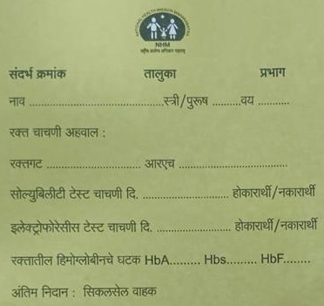
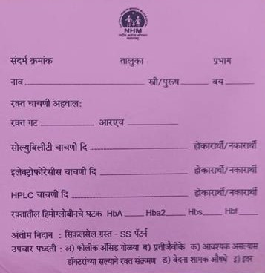
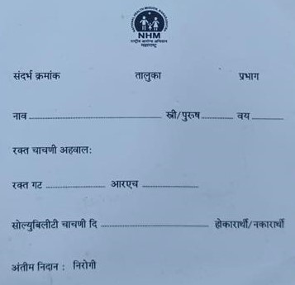
Counseling Services
Counseling services for sickle cell are provided as follows:
Overview of Sickle Cell Disease
Screening and confirmatory testing
Signs and symptoms, management
Preventive Management
Nutritional Counseling
Pre-marital counseling
Pre-conception counseling
Counseling to ANC mothers
Pre-natal counseling
Counseling for SCD individuals and their caregivers
Social Support Schemes
Yellow card: Disease SS Individual
Yellow card: Carrier AS Individual
A counseling checklist is also added in the treatment card on similar points
A counseling module has been prepared which will be disseminated to all districts.
Earlier white, pink and yellow cards were given to normal, disease and carrier individuals respectively by the state.
White card: Normal Individual

Slide 9
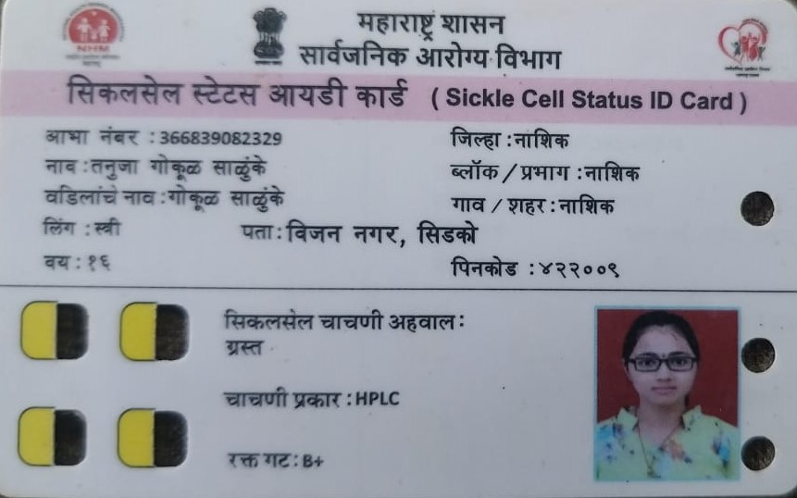
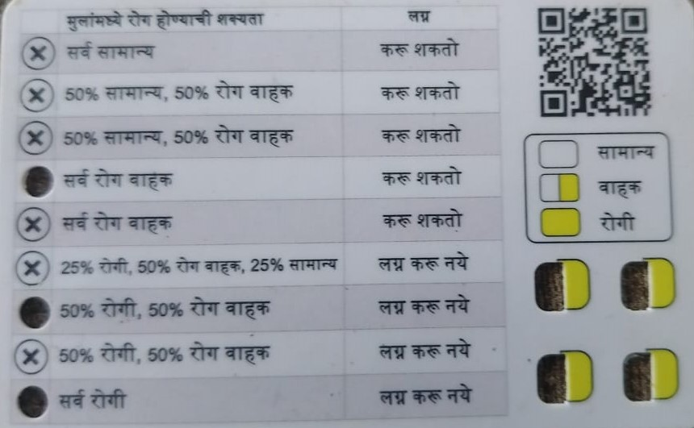
Counseling Services
GOI has launched new Sickle cell genetic counseling cards through which matching possibilities can be determined
Procurement and distribution of these cards is a very time consuming process.
Line list of carriers, disease and normal individuals have to be downloaded from the portal.
Then it is translated into the local language, verified and de-duplicated.
It is then sent to the printing agency which we again takes 1-2 months time to supply the cards.
It would be easier if state could procure blank cards and write individual details or issue old handwritten cards and distribute them real time esp. to sickle negative individuals.

Slide 10
Role of AB-AAMs is Central to SCD Elimination
Ayushman Bharat Health & Wellness Center: AAM-SC and AAM-PHC
HWC Team
Community Platforms
ASHA, ANM, CHO, Staff Nurse & Medical Officer
JAS, VHSNC, Health Mela,
Peer Educator Program, Patient Support Groups, SHGs & Blood Donor Pool

Slide 11
Treatment protocol
Screening in outreach camps / tribal schools/ healthcare facilities
Solubility test positive
Confirmation with HPLC
Holistic Management
Preventive
Therapeutic
Crisis Management
Rehabilitative
Counseling
Maintain hydration
Immunization
Folic Acid
Tab Pentid
Micronutrient supplementation
Counselling & Awareness
Yoga
HU 9 months and above 10 to 15mg/kg of body weight
Hydroxyurea available in 500mg capsule and 200 mg tablets.
Pain relief using NSAIDS, Opioids
Infection Management using IV antibiotics
Blood transfusion and Ventilator support if needed
Social Support Schemes
Avoid:
High altitude
Over exertion
Dehydration
Early recognition of crisis
Working in high temperature environment

Slide 12
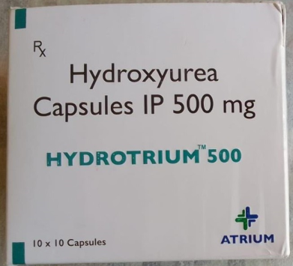
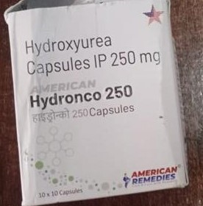
Treatment with Hydroxyurea
1. All individuals with SCD are initiated on treatment with Hydroxyurea irrespective of crisis episodes or severity of symptoms.
2. Funds have been allocated to districts for local procurement of Hydroxyurea.
3. Hydroxyurea to be prescribed up to PHC* level. Facility for baseline investigations (CBC,LFT,RFT) has been made available at all PHCs to ensure that all patients can be started on Hydroxyurea.
4. Sickle cell treatment card is being developed to be create longitudinal treatment records and improve adherence of SCD patients.
5. HU is now being included in the state EDL. Efforts are being made to ensure uninterrupted supply of Hydroxyurea
6. Gadchiroli district has procured 250mg HU capsule

Slide 13
Danger signs and referral
TERTIARY CENTRE/MEDICAL COLLEGES
Specialist consultation
Special blood or radiographical investigations.
Surgical Operations like hip replacement, splenectomy etc
DH LEVEL
-Urgent ICU admission
-Severe signs and symptoms of SCD/danger signs*
Blood transfusion as per requirement
High risk pregnancy with SCD
Specialist consultation
Special blood or radiographical investigations
RH / SDH LEVEL
Urgent Hospitalization needed
Severe signs and symptoms of SCD/danger signs*
PHC LEVEL
Pain not responding to NSAIDS.
Crisis episode or any other complications
*DANGER SIGNS
Chest pain or shortness of breath
Severe abdominal pain with distension
Any pain associated with severe pallor
Joint pain, swelling, redness
Severe headache or limb weakness
Stroke
cases below 2 years age should be considered as high risk
Pregnancy with SCD should be considered as high risk
Referral pathway-

Slide 14
Quality care in Sickle cell patient management
What is Quality care?: patient centric, safe, timely, adequate care
Uninterrupted supply of validated tests kits, ICMR validated PoC test kits.
Availability of adequate and safe blood and blood components preferably NAT tested in districts.
Blood Transfusion
Diagnostics
100% Screening of target group including new borne and ANCs.
Solubility and point of care tests used
Pre- marital, pre-conception, pre-natal and ANC counseling services at healthcare facility level
Screening
Counseling services
Confirmation
Confirmation for all positive cases by HPLC
Adult immunization for pneumococcal and meningococcal vaccine
Immunization
Uninterrupted medicine supply.
Availability of Hydroxyurea till PHC (syrup form for paediatric cases).
Separate ward for sickle cell patients at district level.
Treatment
Death audit for sickle cell disease deaths should be carried out.
Death
Timely referral of complicated cases to higher centres.
Linkages with Centre of Excellence
Availability of all data points in one portal helping in data analysis. eg. ANCs, infants, children etc.
Referral
services
Data analysis

Slide 15
Capacity building of healthcare staff
Training of medical officers in programmatic guidelines and hydroxyurea protocol have been conducted .
Cascading training for the same for CHOs, ANMs, ASHAs, MPWs have also been done in few districts.
Webinar for sickle cell disease management by SHSRC was conducted by subject experts for medical officers of the state
Currently webinar series on sickle cell disease is ongoing through iECHO platform by BMT centre experts for medical officers every Wednesday.
Knowledge products are being developed and disseminated to districts :
-Flow charts for screening and diagnosis,
-Cadre specific training materials for – Medical Officers, CHOs, LTs, ANM/ASHAs, Counsellors,
-Hydroxyurea-based treatment protocol,
-Weight-based dose chart

Slide 16
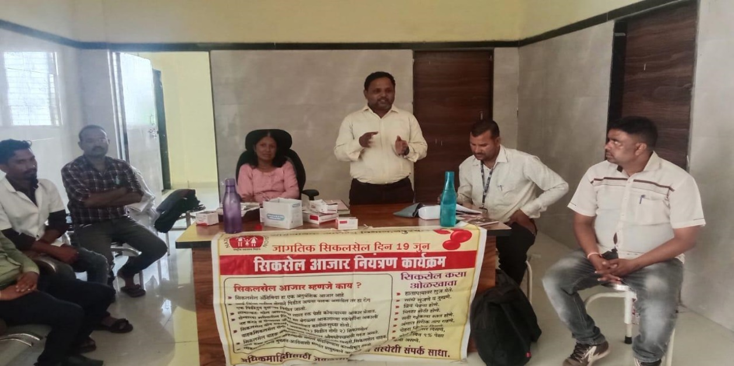
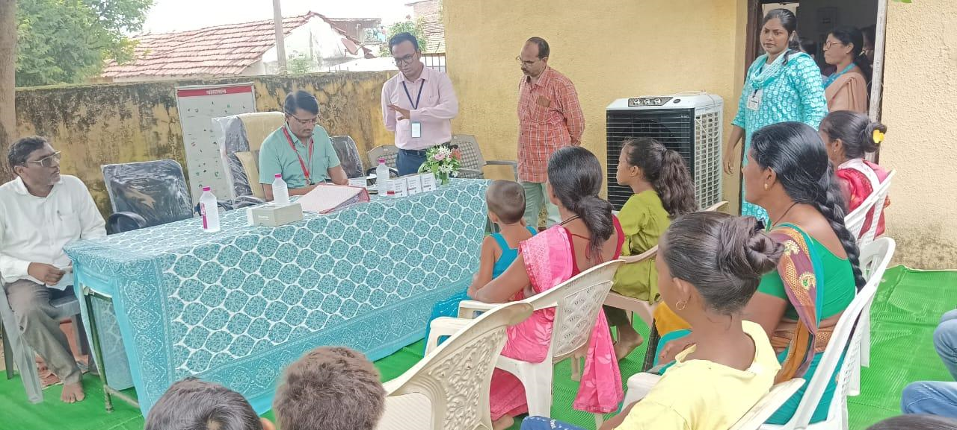
Patient Support Group
A process innovation in the form of ‘Patient support groups’ is being facilitated and piloted with support from PATH, in 2 districts of Maharashtra: Nandurbar and Gadhchiroli.
Purpose: PSGs aim at improving treatment adherence, encourage healthy lifestyles, and empower patients to take care of their health.
Learnings and experiences were taken from PSG established by JSS at Chhattisgarh and Madhya Pradesh through exposure visits and virtual trainings.
Established at AAM (PHC/SC) level (primary care focused).
MOs, CHOs, ASHAs trained and sensitized about PSG concept, meeting agenda and preparation.
Line list of SCD patients maintained by ASHAs.
Concerned patients and their relatives informed about PSG meeting and encouraged on PSG.
Starting from August 2024, five PSGs initiated in Nandurbar district and regular meetings are happening every month.
Plan: To pilot about 18 PSGs initially in both the districts and based on learning, institutionalize the activity at PHC / SC level for the entire state.

Slide 17
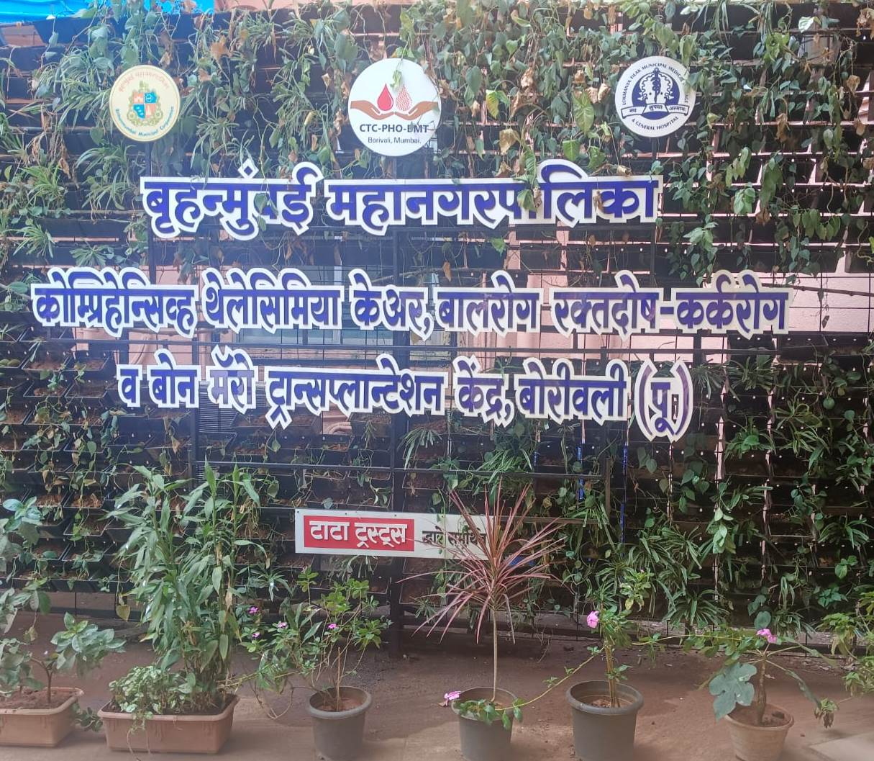
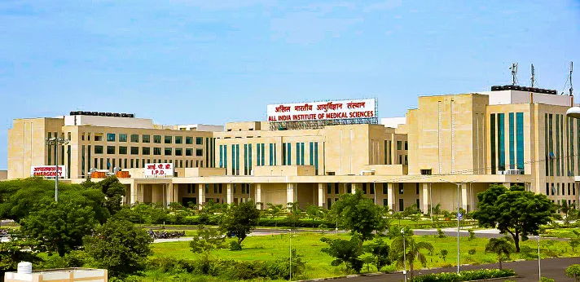
Centre of Excellence
Centre of Excellence proposals from following 2 tertiary care institutes submitted for approvals:
Bone Marrow Transplant Centre, Thalassemia Care Centre, MCGM, Borivali
All India Institute of Medical Sciences, Nagpur

Slide 18
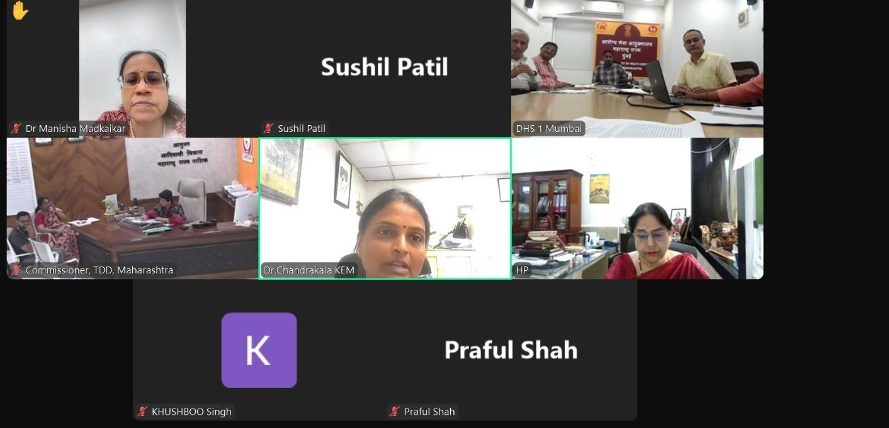
Coordination Committees at State, district and block level
State
Level
District Level Committee
(operational planning, implementation, field monitoring and review)
Block Level Committee
(operational planning, implementation, field monitoring and review)
A nodal person for sickle to be appointed by all the stakeholders to streamline sickle activities.
Recent state level committee meeting was held on 9th Oct 2024.
Sub-committee of the State Health Society - drive policy, technical support and overall monitoring.
Chaired by the Hon. Commissioner, Health Services and Mission Director, NHM and co-chaired by the Commissioner, Tribal Development Department, Nashik

Slide 19
Stakeholders for Coordination Committees
1. Public Health Department
2. Tribal Development Department
3. Primary/ Secondary Education Department
4. Department of Medical Education and Research
5. Women and Child Development
6. Social Welfare Department

Slide 20
Collaborations with PHD, Maharashtra
ICMR NIIH,CRMCH
BMT Centre, Mumbai
AIIMS Nagpur
SHSRC, Pune
Directorate of Medical Education
PATH
Providing technical guidance on sickle cell disease as well as research.
Referral patient care, technical guidance and trainings.
Patient care as well as technical guidance on SCD management
Conducting virtual training sessions
Collaborating on the screening, diagnosis, patient care and CVS testing (in future)
Technical assistance on -
Strengthening SCD program and NSCAEM activities,
Knowledge product preparation,
Monitoring program implementation – at state level and Nandurbar and Gadchiroli,
innovations implementation

Slide 21
Social support schemes
Free Travel on State Transport Buses: 100% concession on state transport bus fare when used for travelling for treatment of SCD.
Sanjay Gandhi Niradhar Yojana: under this scheme, SCD sufferers receive Rs. 1500/- per month.
State Blood Transfusion Council Card: This special card is issued to SS pattern patients by the State Blood Transfusion Council. This card enables SS pattern patients to avail free of cost blood bags for blood transfusion from govt. and private blood banks.
Disability Certificate: Individuals with SCD are now recognized under Rights of Persons with Disability Act 2016.
Department of Education: Sickle cell patients will get extra half an hour in the exam.
Mahatma Jyotiba Phule Jan Arogya Yojana: Sickle cell crisis, blood transfusion, AVN femur are included in the package.

Slide 22
Current status of Maharashtra
S.No. | District Name | Screening | Screening Target (2023-25) | Screening target achieved(%) | Sickle Cell Carrier | Sickle Cell Disease | Patients On Hydroxyurea | Cards Distributed
1 | NASHIK | 3,98,057 | 4,00,000 | 99.5% | 310 | 55 | 0 | 8,484
2 | AMRAVATI | 3,42,886 | 4,00,183 | 85.7% | 3,500 | 1,932 | 80 | 46,603
3 | GADCHIROLI | 2,62,229 | 3,10,000 | 84.6% | 24,006 | 4,556 | 499 | 16,177
4 | NAGPUR | 3,14,187 | 3,90,000 | 80.6% | 36,049 | 2,924 | 821 | 1,47,877
5 | YAVATMAL | 2,57,395 | 3,20,000 | 80.4% | 9,377 | 1,431 | 628 | 98,444
6 | THANE | 2,48,305 | 3,10,000 | 80.1% | 3,895 | 920 | 39 | 17,590
7 | CHANDRAPUR | 2,84,978 | 3,70,000 | 77.0% | 12,222 | 1,344 | 543 | 84,660
8 | WASHIM | 1,76,038 | 2,36,740 | 74.4% | 146 | 14 | 1 | 78,241
9 | NANDED | 1,93,041 | 2,60,000 | 74.2% | 1,295 | 158 | 84 | 38,834
10 | PALGHAR | 2,28,609 | 3,12,000 | 73.3% | 1,728 | 103 | 15 | 15,321
11 | DHULE | 1,74,993 | 2,45,000 | 71.4% | 832 | 120 | 118 | 10,309
12 | C SAMBHAJI NAGAR | 1,82,250 | 2,61,000 | 69.8% | 403 | 74 | 1 | 36,554
13 | BHANDARA | 1,86,570 | 2,70,000 | 69.1% | 14,373 | 945 | 82 | 42,857
14 | HINGOLI | 1,52,887 | 2,25,000 | 67.9% | 464 | 23 | 0 | 6,187
15 | RAIGAD | 1,72,469 | 2,60,000 | 66.3% | 335 | 42 | 3 | 12,613
16 | AKOLA | 1,98,689 | 3,00,000 | 66.2% | 620 | 118 | 0 | 15,822
17 | JALGAON | 2,03,310 | 3,10,000 | 65.6% | 804 | 119 | 7 | 50,624
18 | GONDIA | 1,71,477 | 2,70,000 | 63.5% | 5,171 | 1,552 | 56 | 9,329
19 | NANDURBAR | 1,94,438 | 3,20,000 | 60.8% | 6,120 | 1,325 | 14 | 7,961
20 | WARDHA | 1,63,193 | 2,70,000 | 60.4% | 21,489 | 1,008 | 519 | 9,128
21 | BULDHANA | 1,28,166 | 2,50,000 | 51.3% | 1,049 | 296 | 0 | 30,040
 | Total | 46,34,167 | 62,89,923 | 73.7% | 1,44,188 | 19,059 | 3,510 | 7,83,678

Slide 23
Way Forward
The Public health department, strives to achieve the national goal of eliminating sickle cell disease as a public health issue by 2047 by strengthening the programmatic services.
Interdepartmental coordination and collaboration between various departments like TDD, medical education, ICDS, education dept. etc. and national health programmes like RBSK, RKSK to provide a more comprehensive and holistic service to the patients.
Creating community awareness with regular follow up in community meetings and gatherings.
Strengthening pre-natal sample collection and testing capacity through medical colleges
Strengthening supply chain of drugs and diagnostics
Confidence and capacity building among care providers for HU based management of sickle cell cases and complications by refresher trainings
Scaling up PSG to other districts of state

Slide 24
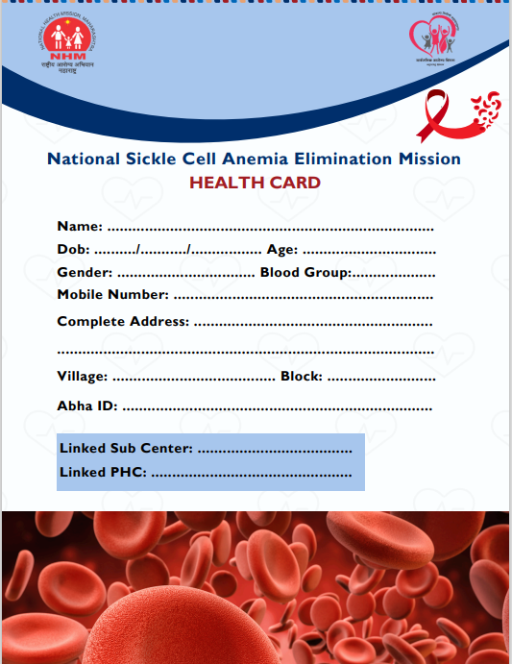
Way Forward
Creation and dissemination of –
Simpler SOPs, algorithms and tools targeted at MOs and physicians for HU based treatment and drug charts
Standard records for streamlining management of SCD patients.
State action plan and documentation for stakeholder engagement and coordinated effort.

Slide 25
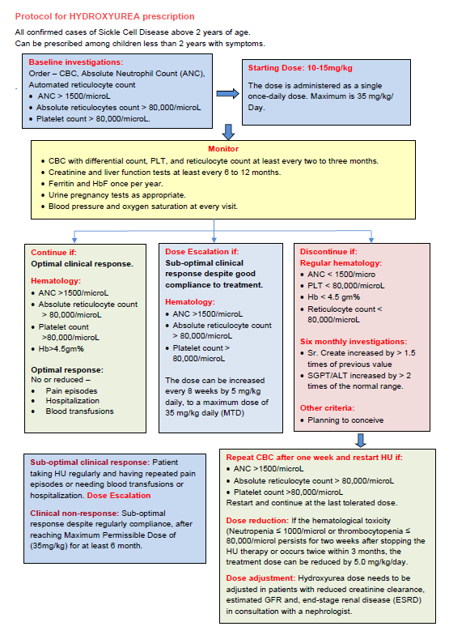
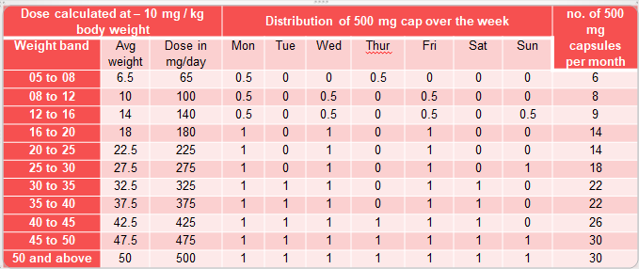
Way Forward

Slide 26
Suggestions to improve quality care for SCD patients
Patient care flow:
1. Screening**
2. Confirmation by HPLC
4. Counseling (pre-marital, - Pre conceptional, prenatal***)
5. Initiation of treatment (on Hydroxyurea)
Follow up visits
Referral / Hospitalization
Program management processes:
Currently Sickle app records - committee meetings at various levels including State, District and Block levels
Card distribution, data points for program monitoring indicators like compliance to care, complications rate, blood transfusion requirement, adverse outcomes etc can be added and regularly monitored.
** While cumulative screening details are available, segregated details on special target groups like ANC, school children, newborns could be made available separately for monitoring screening in respective target groups.
*** Prenatal screening and cascading screening and management could be included in the application.
Analysis based on follow visits could be made available to assess continued linkage to care and adherence to treatment.

Slide 27
Suggestions to improve quality care for SCD patients
1. POC test: The operational guidelines for sickle cell recommend using GOI approved POC test as one step confirmatory approach for sickle cell diagnosis.
However, HPLC testing before initiating treatment with hydroxyurea may be required.
It would be very useful if guidelines on the status of POC tests as screening or confirmatory is issued to ease the process of treatment initiation and confirmatory diagnosis.
Auto disposable lancet should be used for pricking to minimize pain

Slide 28
Thank you!!
Let us join hands.
Together, we can enhance the quality of life for people with Sickle Cell Disease, reduce transmission, and achieve the goal of our National Mission!

